Slide 1


Corporate Sustainability Council
Kick off Meeting
May 04 – 7. 30pm
WOMEN´S INDIAN CHAMBER OF COMMERCE AND INDUSTRY
www.wicci.in

Slide 2
President : Sonali Dutta
Vice President : Disha Banerjee
Members
Anuradha Dixit
Deepa Rajganesh
Gitanjali Solanki
Gina Krishnan
Indraani Singh
Leena Bhanot
Nalini Fernandez
Nanda Dave
Naumita Chopra
Nivedita Jadhav
Padma Chankravadhanula
Renuka Salwan
Rohini Khuller
Roshini Easow
Sameera Satija
Seema Seth
Shalini Tayal
Sumedha Dutta
Sushmita Singha
Tina Pathak
Vibha Malhotra
Welcoming
Council Members to
WICCI

Slide 3

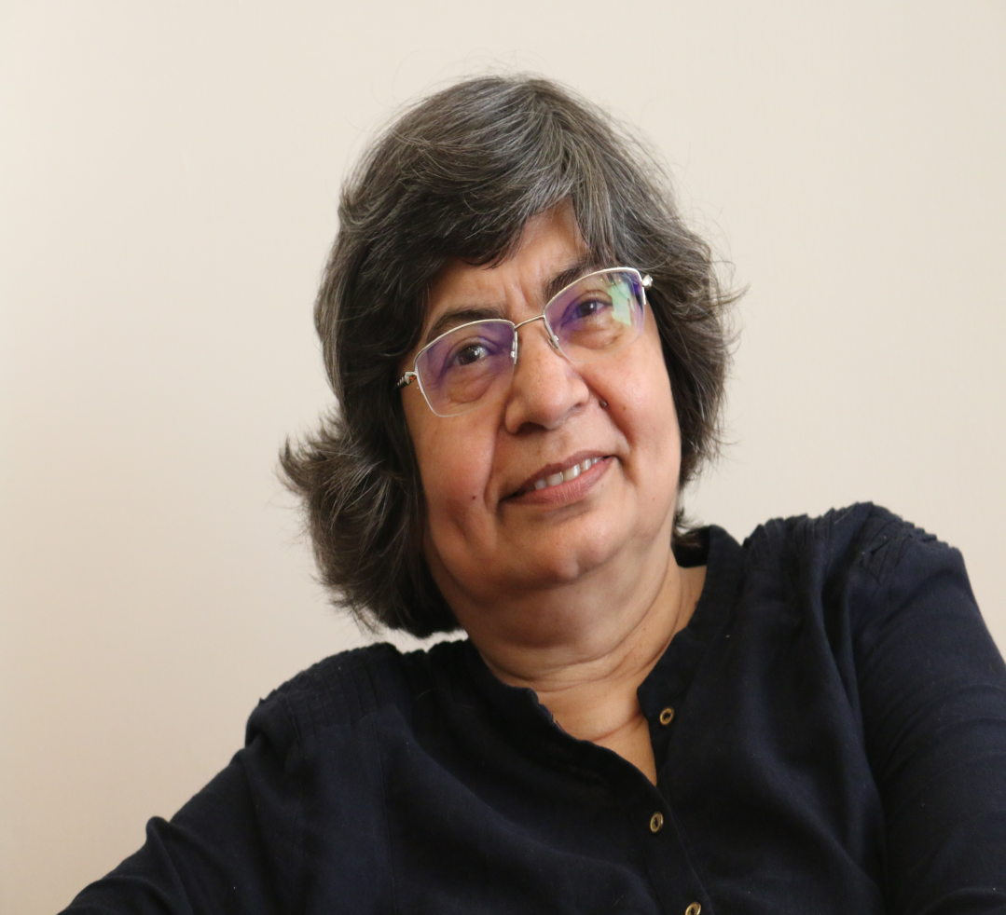
PRESIDENT - Corporate Sustainability Council NAME : SONALI DUTTA
36 years of experience in diverse areas such as Market Research, Sales, Marketing, Advocacy, Branding, Intellectual Property, Contract and Licensing Agreements, HR, and Corporate Responsibility and Initiatives, particularly market and human resource development in various geographies, particularly in South East Asia, China, USA and of course India. Honours in English Literature and Postgraduate in Economics, with Diplomas in Marketing Management and Training & Development.
Last position held Vice President-Corporate Affairs &HR, Bry-Air, and Pahwa. Group. Worked with Bry-Air for 33 years and was a member of the Management Committee. Wore multiple hats, some being :
Chairperson, ICC, POSH, Pahwa Group,
Head, Bry-Air Awards for Excellence in HVAC&R,
Board Member, Bry-Air Learning Institute
National Chair Advocacy, ISHRAE (Indian Society of Heating, Refrigeration, Air-Conditioning Engineers
Member, Board of Advisors, Literacy India (NGO)
Member Interview Board, Go Sports for selection of Para Athletes for the Para Olympian program
Member of the women’s security committee of Mash Virtual & Zammit India Pvt. Ltd
External Member, POSH Committee, Literacy India.
Currently live between Goa and Gurgaon…
An Organic Farmer
Consultant- Responsible Business Practices and Branding
G100 -Advisory Member, World Peace, Haryana State Council
National President, Corporate Sustainability Council, WICCI
Reason to Join: Wanted to Raise Awareness on this sector
Opportunity to work with friends and get connected to new likeminded Women
45 Second introduction

Slide 4
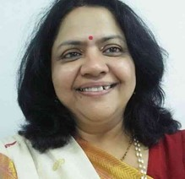
VP - Corporate Sustainability Council NAME : DISHA BANERJEE
Experience in Consulting/ Advisory Assignments for Government relations and policy advocacy in Climate Policy Initiative (CPI), Smart Power India (SPI), Electricity Access and electricity services – E&Y, NITI Aayog, Research Triangle Initiative RTI
Have an In-depth knowledge of Govt decision making and implementation processes, relationship with the media and a technical competence in India’s energy sector including renewable energy from its early days
I have worked as
Director, Policy and Communications, Smart Power India of Rockefeller Foundation
Vice President, Business and Policy, Affairs Welspun and Secretary General, Solar Power Developers Association
Head of Policy, Tata Power Solar
Vice President, Corporate Affairs, SREI Group
Senior Director Government Relations and PR, IEEMA
VP Corporate Communications and Relationship Management, MW Group of Companies
Freelance Customised Research and Government outreach strategy for various Companies on hydro & renewable energy
TERI, Zoom Developers, Perfect Relations, Vaishnavi Corp Comm,
Deputy Director & Head, Americas Desk , FICCI
Director, International, ASSOCHAM
Head, Operations, INDO-AMERICAN CHAMBER OF COMMERCE
45 Second introduction

Slide 5
MEMBER - Corporate Sustainability Council NAME : ANURADHA DIXIT
35 + YEARS PRACTICE IN SUPREME COURT, HIGH COURTS OF DIFFERENT STATES AND DISTRICT COURTS
PRACTICE AREAS
Family Law, Business Law (Or Commercial Law); Commercial Litigation, Administrative Law, Adoption Law, Alternative Dispute Resolution, Bankruptcy Law (Creditor Debtor Rights Law Or Insolvency And Reorganization Law), Business Law (Or Commercial Law); Commercial Litigation, Business Organizations Law (Or Companies Law), Constitutional Law, Consumer Law, Contract Law, Corporate Law (Or Company Law), Also Corporate Compliance Law And Corporate Governance Law, Criminal Law, Defamation
Based out of Gaziabad and practice pan India
45 Second introduction

Slide 6

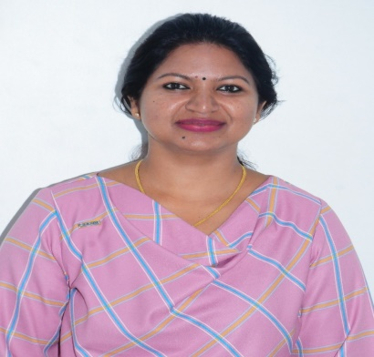
MEMBER - Corporate Sustainability Council NAME : Deepa Rajanesh
______________
An Electronics Engineering graduate from SJC Institute of Technology, Bangalore University. She started her career in Aviation industry and possesses 13+ years of experience in Avionics software verification & development. She has worked on Integrated Global Avionics, Flight control system, Fire Protection System with clients at US, Germany and Israel.
Since 2015, she ventured her own business unit Arctic Traders, as Business Partner. The company deals with various HVAC products and are the distributor of Kruger Ventilation Industries India Pvt Ltd for Karnataka region. She looks in to various verticals of Marketing and Business Development.
She is an active member of ISHRAE since 2017. She served as National Women Chair at ISHRAE 2021-23 and currently serving as South Zone Program Chair, Program Chait at RATA Bangalore and committee member at ISHRAE Bangalore Chapter. She is also member of ASHRAE Bangalore.
45 Second introduction

Slide 7
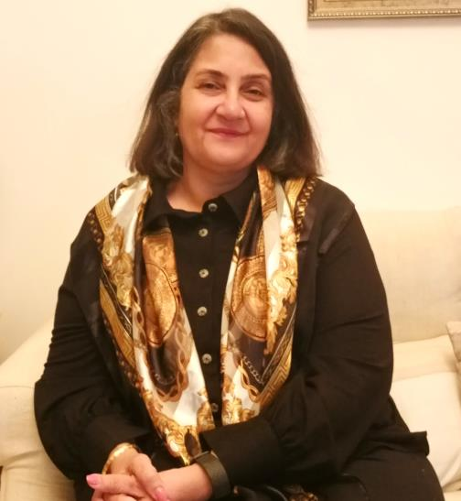
MEMBER - Corporate Sustainability Council NAME Geetanjali Solanki
I have over 23 years of experience in the HR and Management space. I have worked with many reputed brans like Levi’s, CBRE and C&W as Head of the HR function where I have been responsible for large ramp ups and technology interventions. During the period of 2017 and 2019 I was a POSH consultant and have worked with over 17 organizations as an External Consultant on their ICC and trained more than 3000 employees on the Act. I am currently Country Manager, India of Cotton Connect South Asis with responsibility of India and Pakistan operations and all global functions out of India. CCSA is a social enterprise and has impacted the lives of over 5ooooo farmers and currently too we are working with close to 300000 women farmers to create awareness of using sustainable farming practices and bring about a strong movement towards gender environment.
I am based in Noida
The CSC will be step forward to share our work and learn more about what other individuals and organisations are doing in this space
45 Second introduction

Slide 8
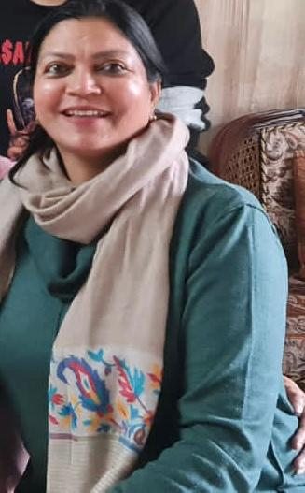
MEMBER - Corporate Sustainability Council NAME : GINA KRISHNAN
______________
An independent business journalist with deep interest in healthcare and pharmaceutical industry. She has been writing for twenty years for various publications.
Her major interest is in community composting, solid waste management and sustainable living. She along with a team of fellow residents set up a community composting project which was celebrated in Gurgaon.
She spends her spare time reading and working on rescue of strays.
45 Second introduction

Slide 9
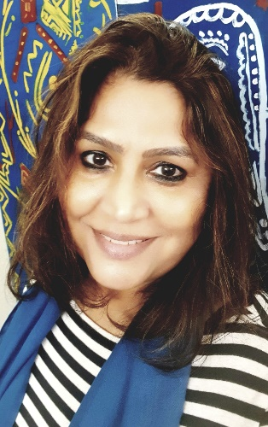
MEMBER - Corporate Sustainability Council NAME : indraani singh
Started in 1987 with Indian Airlines, flying the Boeing 737. Was the World’s first woman commander on the Wide-bodied Airbus -300 after being trained in Toulouse, France
As a Managing Trustee for the non-profit organisation Literacy India, is spearheading the 4Es of Education, Empowerment, Employability & Environment at the grassroot level impacting and empowering over 8,00,000 children, youth and women through its various programmes and initiatives. As part of Literacy India’s vision to teach every child from underserved community, Captain Indraani has made good use of tech-solutions like ‘Gyantantra-Digital Dost’ to offer unique solutions at its centres. As a result of this program, 300,000 children have achieved a stronger foundation in primary education and 106 learning centres across the country have been set up. This multimedia-paced educational software has become not only children’s favourite but also opened doors to livelihood.
As the Head of the enterprise and brand “INDHA” specially created to give wings to women empowerment program. Under the program over 350+ woman have been trained and now work as skilled artisans earning their livelihood from the rural areas of Haryana, Rajasthan, Jharkhand & West Bengal. INDHA has successfully crafted products for 15 years and continues to sell through all leading online portals and exhibitions and offers corporate gifting solutions.
Awarded and recognised for her initiatives in the social sector through many Awards and recognitions. Among the notable ones are-
Godfrey Philip special award for Bravery in social cause
Limca Book of Records that covered her Brand ‘INDHA’ for achieving Women-Empowerment in India and also featured her for A-300 Command in the World & A-320 in Asia
Women Achievers Award, 2009, by International Congress of Women
45 Second introduction

Slide 10
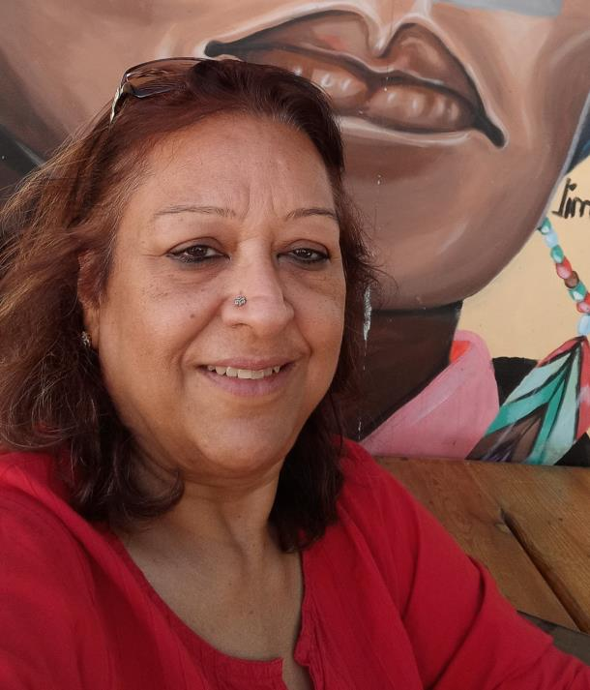
MEMBER - Corporate Sustainability Council NAME : Leena bhanot
I have over 35 years of experience in the non profit sector having worked in different capacities with national Non Profits working in the field of Environment, Reproductive Health, disability and general development. Having travelled the length and breadth of northern, eastern and north-eastern India, I am familiar with the grassroots reality of the country. Currently based in Delhi, am now associated with an organization working in the field of “Healthy aging”.
WICCI & the Corporate Sustainability Council has the potential to deeply impact the country, especially the areas which are still awaiting development or are in the nascent stages of development. If I can in any way, help in this effort, I will consider myself fortunate – this is my effort to give back to the country which has given so much to me….
45 Second introduction

Slide 11
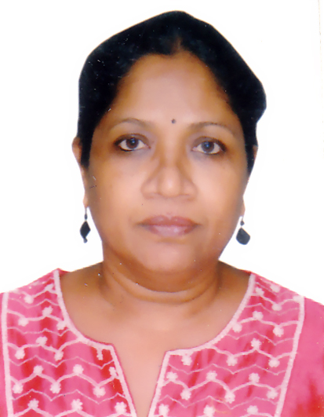
MEMBER - Corporate Sustainability Council NAME : Nalini fernandes
Currently a stay-at-home professional devoting most of my time to writing, reading, teaching professionals to write English effectively and life skills to underprivileged children. Worked over 25 years with international NGOs, bilateral (DFID) and multilateral organisations (UNAIDS). My expertise includes program development and management, administration, grant/fund management; asset and database management; overall operations and office management. Organized, participated in, and produced the proceedings of several national and international training programs/workshops/study tours on a range of development issues in India, Bangkok and Nigeria.
45 Second introduction

Slide 12
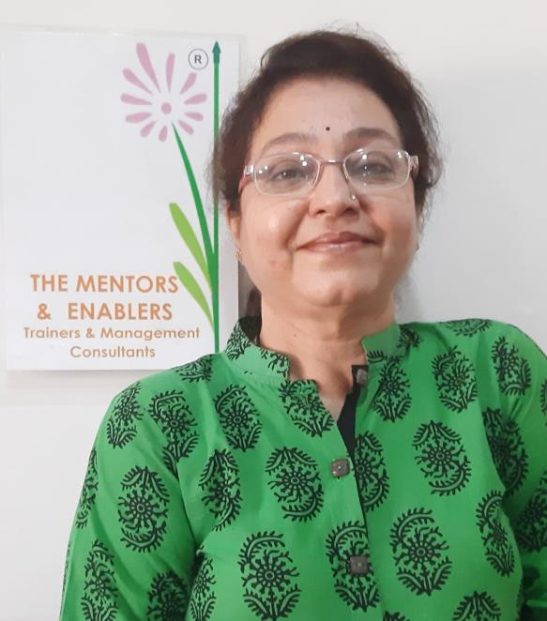
MEMBER - Corporate Sustainability Council NAME : nanda N Dave
Training strategist of repute - Proven track record in training for leadership capability building, enhancing managerial effectiveness
Trained more than 10,000 corporate executives, going on
c) Assessment & Diagnostic expert - Niche in conceptualizing & conducting assessment / development centers, diagnosing organizational health
d) Have been serving as HRD advisor for MSMEs - Coaching MSMEs with respect to people related strategies – offering business growth through Executive Coaching
e) Establish, streamline, strengthen business linked Performance Management system
Insert High Resolution Picture
45 Second introduction

Slide 13
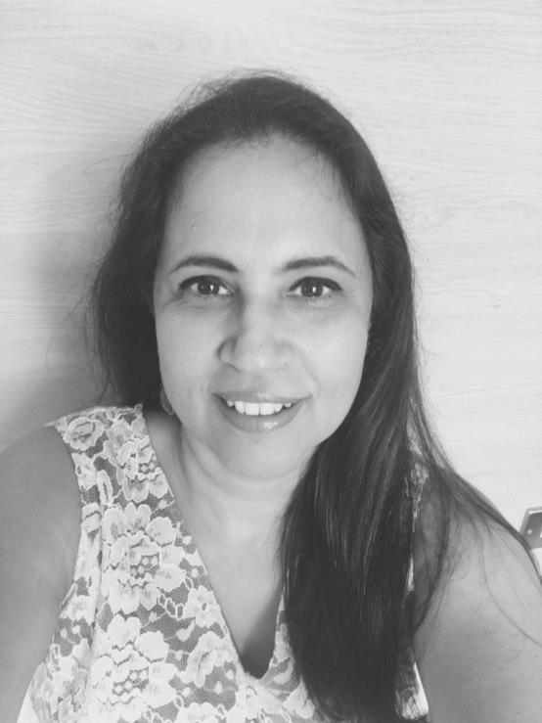
MEMBER - Corporate Sustainability Council Naumita Chopra
25 years+ experience as University Guidance Counsellor
Currently heading Careers Advisory at Pathways School Gurgaon
Blog at: https://trailingwifeblog.wordpress.com/category/trailing-wife/
Enjoy cooking, yoga, movies and travelling
Based in New Delhi
Joined Corporate Sustainability Council to share my experiences and offer my perspective on issues of mutual interest.
45 Second introduction

Slide 14
MEMBER - Corporate Sustainability Council Name : Nivedita Jadhav
I am Nivedita Jadhav from Thane City, Maharashtra. A mechanical engineer moved on to sustainability in the past few years, I am associated with Design2 occupancy Services LLP as a Regional Manager Business Development of Sustainability Projects.
I am the current president of ASHRAE Mumbai chapter and past president of ISHRAE Thane chapter. The Women in ISHRAE initiative was led for the first time by me.
Reason to join this council for sustainability is, firstly it is part of my profession and secondly, I am passionate about it and try to practice it in all walks of my life.
Insert High Resolution Picture
45 Second introduction

Slide 15
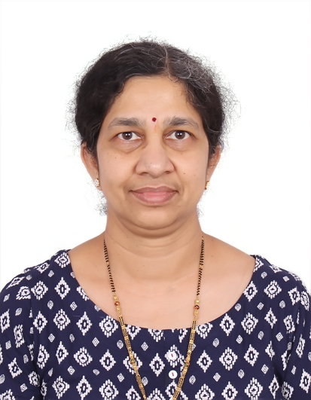
MEMBER - Corporate Sustainability Council NAME : C. Padma
Alumni of NIT and IIT, currently working in Scketch, an Altumind company as COO. Has deep experience in all aspects of running a software company: Strategic planning & Management, Presales, Delivery, Operations, HR, Compliances and Business process automation. Is a Member of Executive committee. Travelled extensively and has international exposure.
45 Second introduction

Slide 16
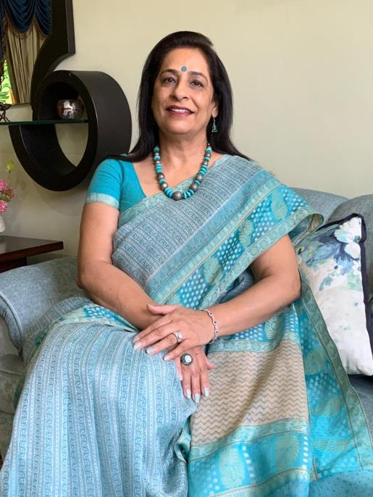
MEMBER - Corporate Sustainability Council NAME : Renuka salwal
Former Director Public Relations, Bureau of Indian Standards and Former Director Public Relations Panjab University is a hardcore Public Relations an Communication professional with almost 36 years of experience and specializes in Strategic Communication for Image building . Her forte also includes Managing Corporate Reputation, Media management - End-to-end planning to execution, for different media activities, Brand management , Holistic-360 degree conceptualization of nationwide publicity programs. Received many awards for her professional excellence. Associated with Chandigarh Management Association as life member and Vice President North of Public Relations Council of India.
45 Second introduction

Slide 17
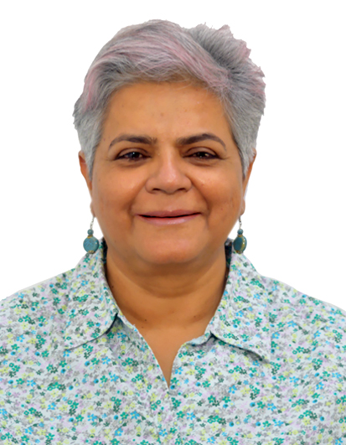
MEMBER - Corporate Sustainability Council NAME : Rohini Khuller
With a total work experience of about 38 years, Ive spent 15 years in the corporate world through various roles primarily in the office automation business– frontline sales, sales management, marketing and training. I worked with companies like Network Communications, Modi Xerox, Ricoh and Canon.
Moved into Consulting space in 2000, with Door Training, Blanchard International & Vitalsmarts
Started off my own company -Turning Point Learning Pvt Ltd in 2011, where I continue to sell, manage sales, market and of course train. Add Coaching and Consulting which completes the circle.
I am based out of Delhi. My reasons of joining the Corporate Sustainability council
I know Sonali for the last 30 odd years
I’d like to be able to plough back my knowledge and see if it helps make the difference
In a true entrepreneurial spirit I’d like to try something different and new
It allows me to meet loads of different people
45 Second introduction

Slide 18
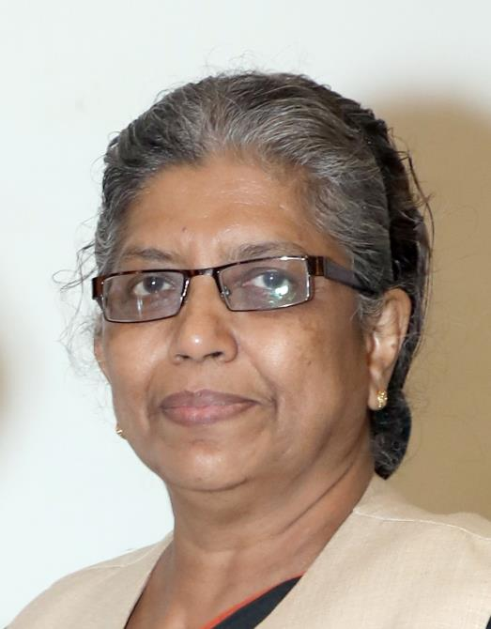
MEMBER - Corporate Sustainability Council
NAME Dr. Roshini R. EASOW
Hi, I am a Mechanical Engineer by training .
I started my working life by a stint in research
in Solar Energy . This was followed by 30 years
as an academician. Right from my UG project in engineering (1977) which was a heat pump, my interest has always been on engineering for sustainability (not a buzz word in those days). I was President of ISHRAE Mumbai chapter and ASHRAE Mumbai chapter. Inherently we Indians used sustainable practices and we need to go back to our roots using tools of modern technology
45 Second introduction

Slide 19
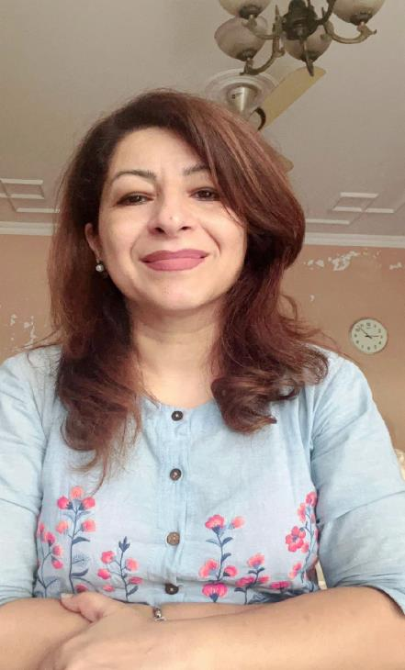
MEMBER - Corporate Sustainability Council NAME : Sameera satija
______________
I am a resident of Gurgaon & a certified trainer by CSE to organise IEC/BCC activities into Waste Management and Sustainable lifestyle. I am a sustainability practitioner myself and currently working on three verticals. 1.Founder ‘Crockery Bank For Everyone’ which is a sustainable alternative to SUP crockery. It’s a free service to provide reusable crockery for all sort of events to reduce waste of SUP items.
2.Haryana State President Bio Enzyme Council and have been making, using, teaching, endorsing Bio Enzyme for the past 5 years.
3. Associated with ‘Astitva’ as Sustainability consultant. Under Astitva we Upcycle and repurpose fabric left over and shredding generated at boutiques/tailoring units and create functional and sustainable gifts items from this waste which otherwise would have landed in the landfills.
45 Second introduction

Slide 20
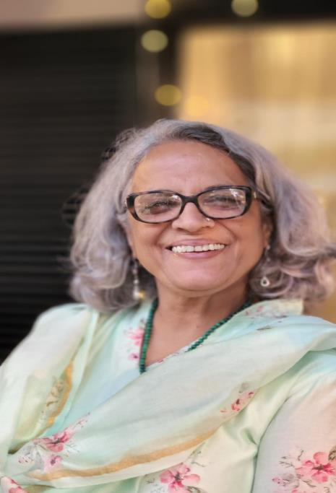
MEMBER - Corporate Sustainability Council NAME : SEEMA SETH
Founder, Nayi Disha, schools for children from marginalized communities. After 25 long years of corporate experience, in 2014 I moved into a “nayi disha” to devote my time to make a difference to the lives of those who needed a little commitment from people like us. I currently work with about 200 children in 2 schools in Gurgaon. I do what I love and love what I do………and I think this council will help me strengthen my endeavor to make a larger difference in areas that need a ‘ ‘sustained’ effort and commitment to nudge the future in a ‘direction’ that will impact society at large.

Slide 21
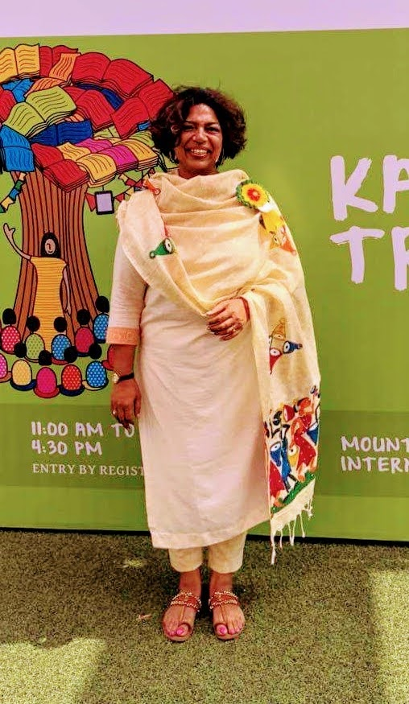
MEMBER - Corporate Sustainability Council NAME Shalini Tayal
A trainer, a storyteller, an educator, an academician and an administrator. I started my career in software development and worked in Delhi and Mumbai for 4 years. Later, I enjoyed 12 fruitful years of administrative and teaching experience in Hyderabad and Mumbai. Once I moved to Gurgaon in 2008, I started writing curriculum books for Educomp wherein I helped to design books in Mathematics and History for the middle school children. I am presently empaneled with Learnet Skills Limited as Master Trainer and with HT Pace, McMillan and Primary Plus as Facilitator and Soft Skills Trainer and am involved in developing and facilitating learning & teaching solutions.
Recently, I was part of a Pan-India program implemented by Learnet Skills Limited under aegis of NSDC with the support of UN Women focusing on creating gender awareness and consciousness amongst the skills trainers. Under this program, I conducted online capacity building training for 500 skill trainers on Gender Mainstreaming. The training focused on creating awareness about the prevalent gender gaps, gender inequality, sexual harassment and sensitization about gender mainstreaming, inclusivity, and responsiveness in the skilling ecosystem etc.
I believe that women-centric and responsible business practices, combined with collaboration and innovation, can bring about powerful change in markets and societies. WICCI is playing an important role in bringing about this change and I look forward to learning and being part of this movement.
45 Second introduction

Slide 22
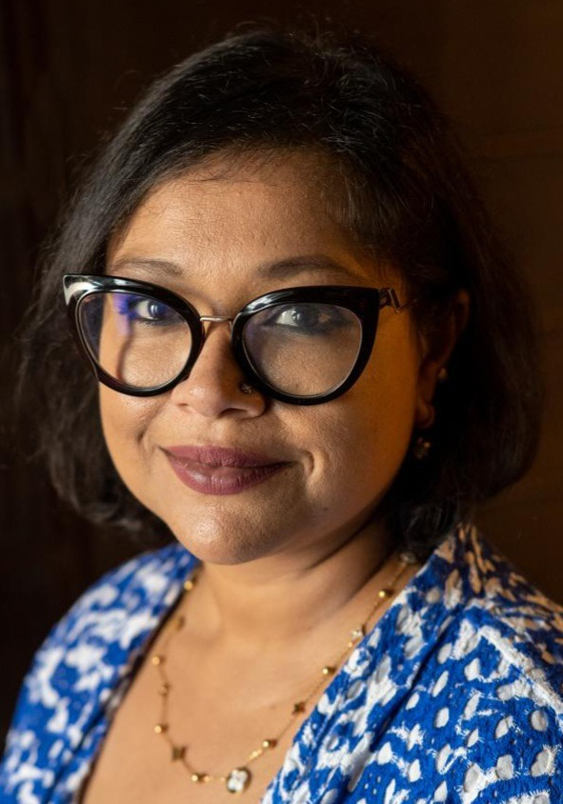
MEMBER - Corporate Sustainability Council SUMEDHA DUTTA
Fintech expert and versatile Country Manager-India for Dlocal, I excel at wearing multiple hats and bringing a unique legal perspective to operations. With over 16 years of industry experience, spanning fintech, corporate M&A, private equity, transaction advisory, and inbound and outbound payments and investments, I have honed my skills while holding leadership positions at some of the most prestigious Indian law firms.
Worked extensively with ADB and World Bank on various Environment, Health and Safety issues from an Indian and Global perspective.
As a passionate advocate for promoting inclusive work environments, I also serve on various POSH-ICC's of several companies.
From 2002-2005 I held the office of the Youth Representative-Asia Pacific Region to the International Council of the International Award for Young Peoples (IAYP). During my tenure I had contributed to various policy making and planning processes for youth empowerment and development including with the United Nations.
Introduction

Slide 23
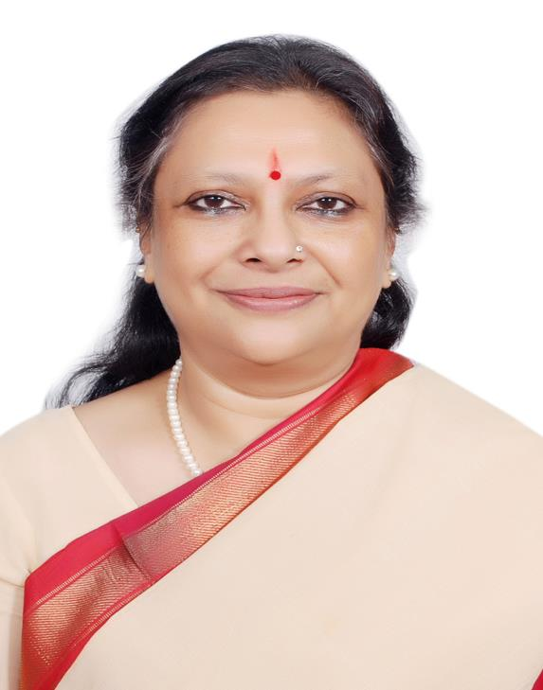
MEMBER - Corporate Sustainability Council NAME : Sushmita singha
With over 35 years of experience in the industry, international organizations and development sector.
Is an Independent Director with 1) Kajaria Ceramics Ltd and Chairman in the CSR Committee, Stakeholders & Relationship Committee & Member of NRC. 2) Radico Khaitan Ltd. & member of CSR Committee 3)Ginni International Ltd & Member CSR & Remuneration Committees
Is a 1) Trustee Member of Online Giving Foundation India (Benevity) 2) Corporate Advisor in BGJC & Associates LLP and Founder of MA.My Anchor Foundation. 3) Honorary Member of BRICS Chamber of Commerce Industry and Member of Expert Panel for CSR Center at BRICS Chamber of Commerce & Industry. 4) member of BSES and Dessicant Motors International’s Internal Committee for handling complaints with respect to Sexual harassment in work place. 5) Founder of JAL Water Museum & Udaipur Tales International Storytelling Festival. 6) Life member of INTACH and works for conservation of heritage.
Was 1) Senior Consultant to REC Power Distribution Company Ltd. 2)Consultant to Blackberrys, Gurgaon, one of India's leading premium fashion brands.3) Secretary General of PHD Chamber of Commerce and Industry, a multi-state apex organization that is a catalyst in the promotion of industry, trade and entrepreneurship. 4) Senior Vice President of Sulabh International Social Service Organization, an internationally renowned and one of the largest NGOs involved in onerous task of improving environmental sanitation.5) Member of the UN Task Force - Millennium Development Committee for water and sanitation as one of the global experts representing the needs of people from their respective regions. She represented South Asia region in the Task Force and contributed in writing the recommendations for MDG. 6) Member of the Task Force on Tenancy Rights, Ministry of Urban Development, Govt. of India and the Vikram Sarabhai Foundation among others. She has also written many articles on social causes for leading newspapers, international journals and also a book titled – Tales from Hindu Mythology. 7)In a project for Ministry of External Affairs, Govt. of India in Afghanistan for a sanitation & hygiene which entailed training, creating awareness and construction of toilets and biogas digesters. 8) Member of National Tourism Advisory Council, Ministry of Tourism, Govt. of India. 9) Was awarded by the Islamic Republic of Afghanistan, Kabul Municipality expressing appreciation for her work in the field of environment, sanitation, promoting school health, hygiene and safety in that country. 10) Recipient of the Desh Sri Environmental award, Sri Lanka and many prestigious awards in India. 11)Member of State Supervisory Board, Department of Health, and Government of Uttar Pradesh. She was also a Visiting Professor - Institute of Management Studies, New Delhi – YMCA and was a Visiting Expert for Centre for Science and Environment, New Delhi.
45 Second introduction

Slide 24
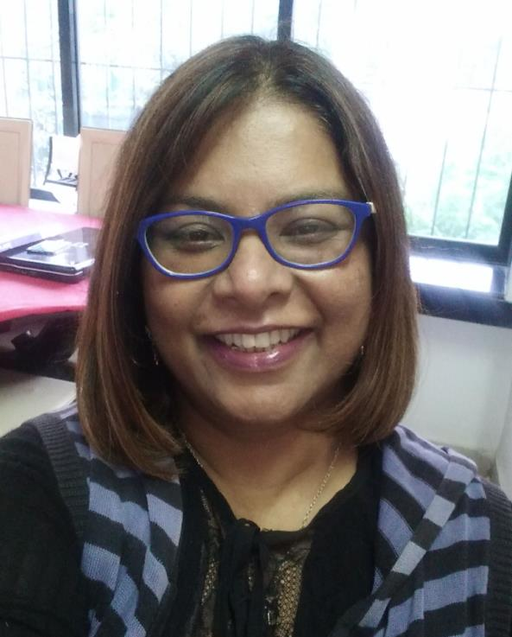
MEMBER - Corporate Sustainability Council NAME : Tina Pathak
A science graduate in mathematics, MBA in Marketing & Hospitality IMS, Indore. Founder & head marketing at Raceme – Integrated Marketing Communications agency for the past 25 years. Founder of Italy in Box has been managing the operations, supply chain and aggregation with online platform and was responsible for its expansion.
Working on water & air CSR projects in the rural areas of India.
Insert High Resolution Picture
45 Second introduction

Slide 25
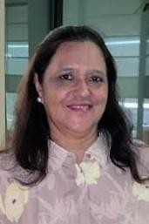
MEMBER - Corporate Sustainability Council NAME VIBHA MALHOTRA
Strategic and innovative HR Professional with proven record of over thirty-five years to translate organization vision into HR initiatives that improve performance. Having worked in diverse organizations which include Corporate, Social Sector, UN, GOI and International Schools, I understand the challenges that various organizations go through.
Having done a master’s degree in social work from Delhi University, I understand the importance of Social Development Goals (SDG), Sustainability and its impact.
As an HR and Training professional, I have expertise in developing HR and Orientation manuals, effectively engaging and communicating policies, procedures and guidelines, Conducting Competency Based Interviews, delivering soft skills programs that encourage and motivate staff to go an extra mile.
45 Second introduction

Slide 26
ABOUT WICCI
5 sister platforms
A National Business Chamber for Women that provides a platform to boost women’s entrepreneurship and businesses through greater engagement with government, institutions, global trade, and networks.
ALL Ladies League (ALL) was set up in 2011 and is a global sisterhood movement in She-for-She spirit uniting women as “sisters beyond borders”;
Women Economic Forum (WEF) is a conference platform for women’s greater visibility, voice, recognition, and networking for pursuing “business beyond borders”;
WICCI is the industry and business chamber for advocating “policies beyond borders”;
SHEconomy is an e-commerce platform and app for both goods and services by women entrepreneurs for strengthening “commerce beyond borders”;
G100 is a global platform for joint action empowering “gender equality beyond borders.”

Slide 27
WICCI VISION
Ensure women’s advancement in all walks of life with an integrated vision and inclusive values.
Through
the Largest global communities of women
AND
Growing toward Mission Million 2023
By
Engaging the support of men

Slide 28
WICCI COUNCILS
Robust inter-disciplinary & cross-sectional structure to enable
Both depth and width of knowledge and leadership from all strata of economy and society
Forming the basis of policy changes at the top levels of decision-making as well as mindset and societal transformation at the grassroots.

Slide 29
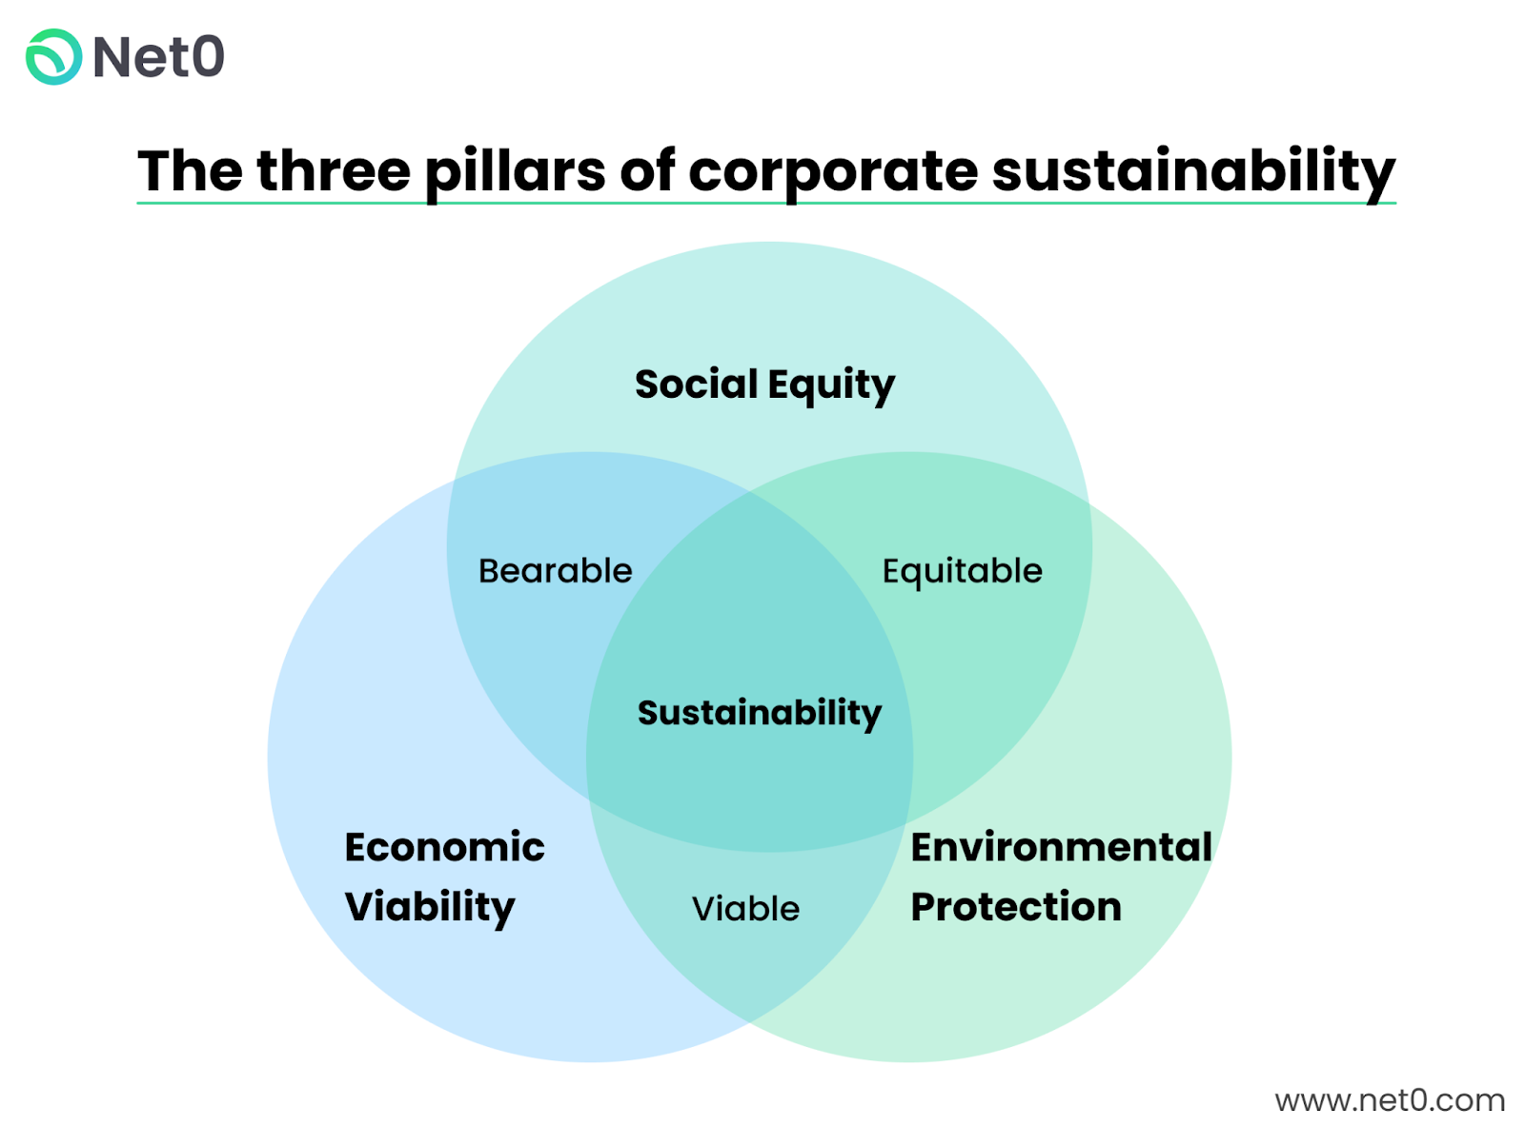
CORPORATE SUSTAINABILITY
DEFINATION & PILLARS

Slide 30
CORPORATE SUSTAINABILITY COUNCIL
VISION & MISSION
Vision
The Council is committed to be a knowledge bank on Corporate Sustainability, providing a learning platform for companies to set up their governance roadmaps
Mission
The Council shall accelerate awareness of Corporate Sustainability through its network and advocacy

Slide 31
RELATED TERMINOLOGIES
Used interchangeably
ESG – Environmental, Social, Goverance
II – Impact Investing
SRI – Sustainable & Responsible Investing
A framework designed to be embedded into an organization's strategy that considers the needs and ways in which to generate value for all organizational stakeholders (such as employees, customers, suppliers, and financiers.
This term emphasizes the idea that investing should not only focus on financial returns, but also take into account environmental, social, and governance factors that can impact the long-term sustainability and success of a company
It emphasizes the intentionality of investing to achieve specific social or environmental goals, and "Corporate Social Responsibility" (CSR), which refers to a company's broader efforts to be accountable to its stakeholders and to operate in a socially and environmentally responsible manner.

Slide 32
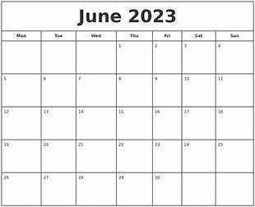
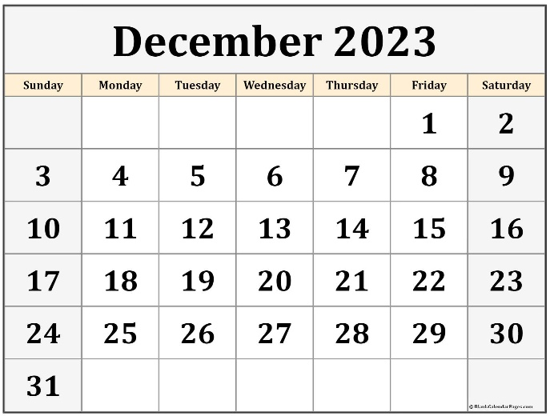
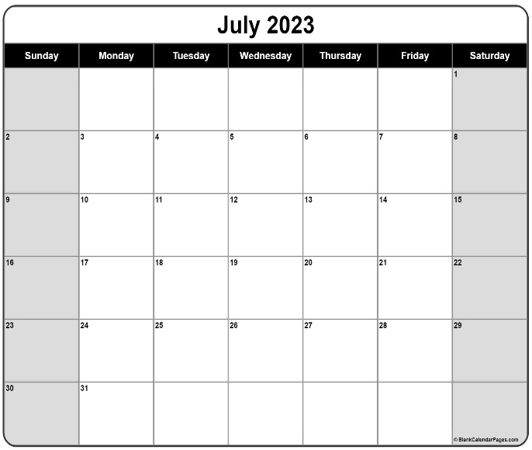
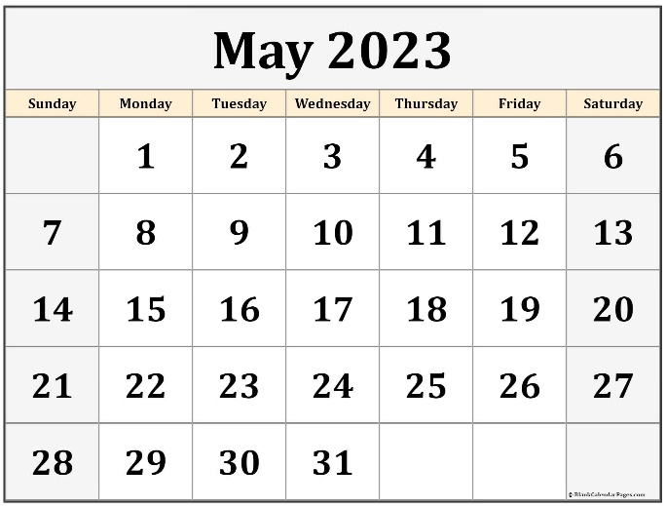

ROAD MAP & MILESTONES
3 STAGES
3
Develop an easy-to-understand "White Paper" and training material for Responsible Business Practices viz inclusivity, empowerment of women, environmental
Guideline/Framework for Corporates to Integrate Corporate Sustainability in their Strategy
3. Identify Organizations to Collaborate
4. Webinar/s
1
1. Webinars to continue
2. Publish papers ( Council members to collaborate )
3. Plan for a big event(Conference)
1. Expand the council to a Countrywide network
2. Orientation Program for the Expanded Network
3. Press and social media release
2
2

Slide 33
President : Sonali Dutta
Vice President : Disha Banerjee
Members
Anuradha Dixit
Deepa Rajganesh
Gitanjali Solanki
Gina Krishnan
Indraani Singh
Leena Bhanot
Nalini Fernandez
Nanda Dave
Naumita Chopra
Nivedita Jadhav
Padma Chankravadhanula
Renuka Salwal
Rohini Khuller
Roshini Easow
Sameera Satija
Seema Seth
Shalini Tayal
Sumedha Dutta
Sushmita Singha
Tina Pathak
Vibha Malhotra
Thank you
Corporate Sustainability Council Members

